Slide 1
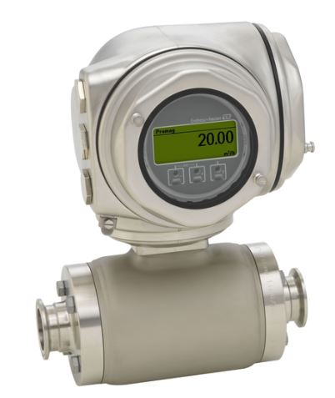
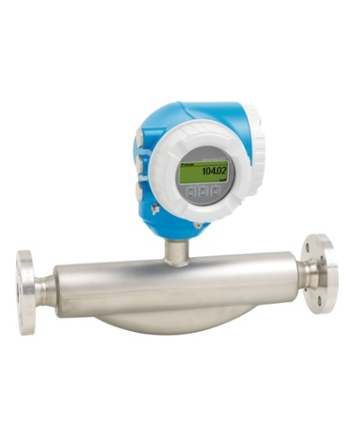
Anticipate Spare parts shortage
E+H Flowmeters
VALUE AND BENEFITS
DESCRIPTION
Safer solution with newer component available in the market.
Can prevent long downtimes in case of failure
  E+H Promass 83/63F and Promag 50H/53H families installed on Several Mixers and Carbo production is stopped by manufacturer.
  Risk of imminent Spare Part unavailability.
  Risk of long Downtime for equipment at Bottlers prod plants.
Communication features: HART, Wireless HART, Profibus PA/DP, Foundation Fields, Modbus RS485, Ethernet IP, Profinet) I/O
Additional Features: ISO/IEC 17025 calibration, Error message archive up to 1000 on logbooks, Diagnostic coverage >95%, IP 66/67 protection with boxing type 4X, Option: IP69K Stainless steel
  New system with E+H updated families of products:
    The new system consists of New Proline 300/500 Flowmeters automation link.
    It includes the necessary PLC Software mods, piping modifications where needed, installation kit and Calibration in production with FSE intervention.
Value: Obsolescence
Equipment: SAE, SAG, SAF, SAM, Mixer and Carbo
Catalogue code: OCM001

