Slide 1



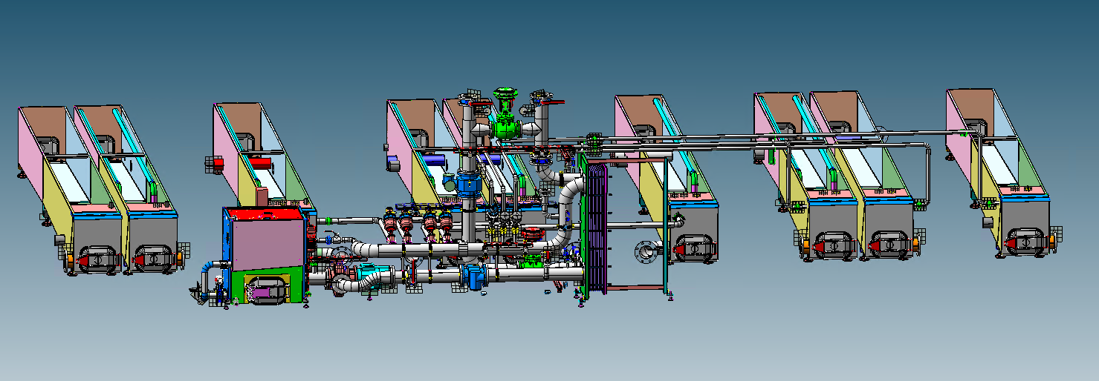
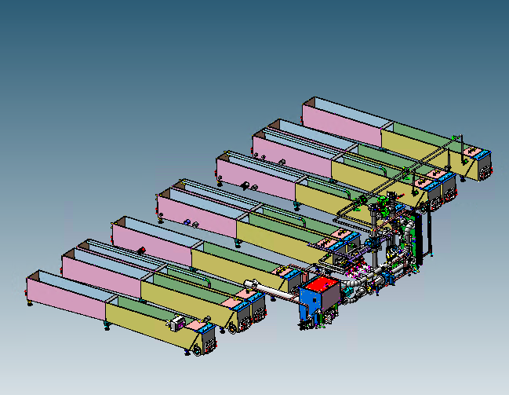
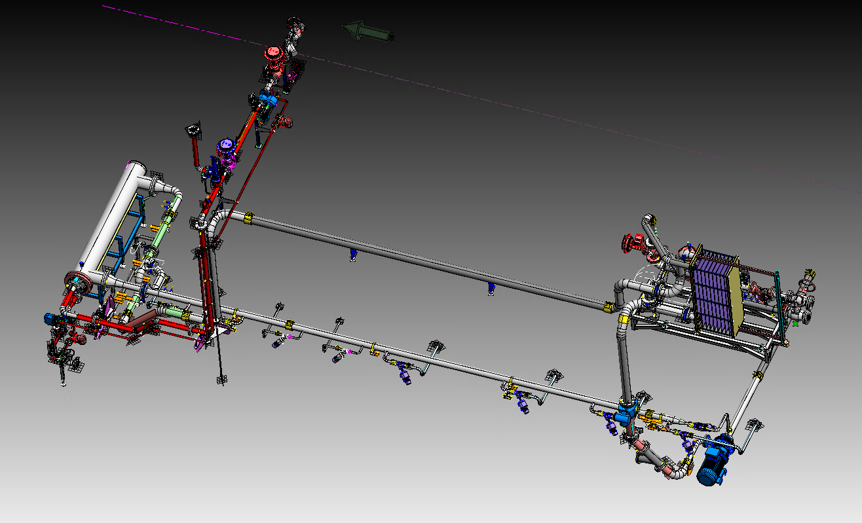
Plant Energy Recovery System
Sustainability
O&U Ref – VRP-025
KEY FIGURES
Budget price:
BENEFITS
DESCRITPION
Easy to install solution
200-250K€*
Conversion from steam/SHW to hot water as heating fluid
Possibility to recover energy from other internal processes savings up to 100% steam
Reduction of CO2 emissions up to 100%
System completely integrated in the pasteurizer control with the possibility of different configurations based on the different energy availability
Continuous monitoring of consumption and energy savings
Possibility to electrify completely the heating system of the pasteurizers using heat pumps
Installation of and additional heating system capable to work in parallel to the traditional heating system and using hot water as heating source.
Replacement or addition of a system capable of recovering thermal energy present in the plant to assist or replace the heating systems of the pasteurizer. Conversion of the heating source from steam to hot water (80-85°C)
Software modification to manage automatically the heating demand of the machine giving priority to the hot water as main source.
Payback estimation:
1-2 yrs
Installation time:
8 days
Machine downtime:
Applicable to competitors machines
5 days
*Installation excluded
Can be combined with:
Prince E
Machine application:
All Sidel pasteurizers/warmers
Competitors machines

