Slide 1



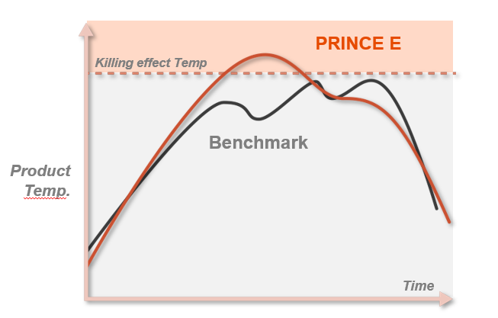
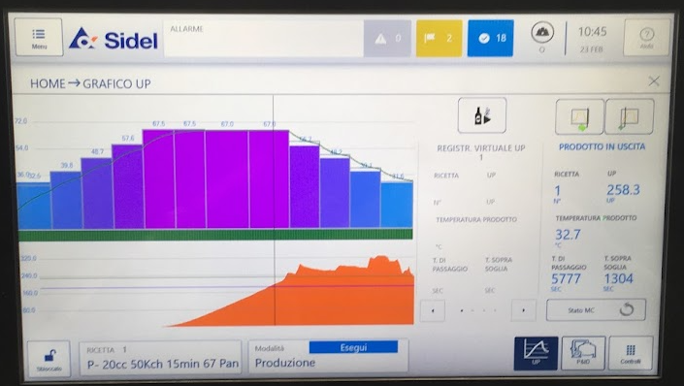
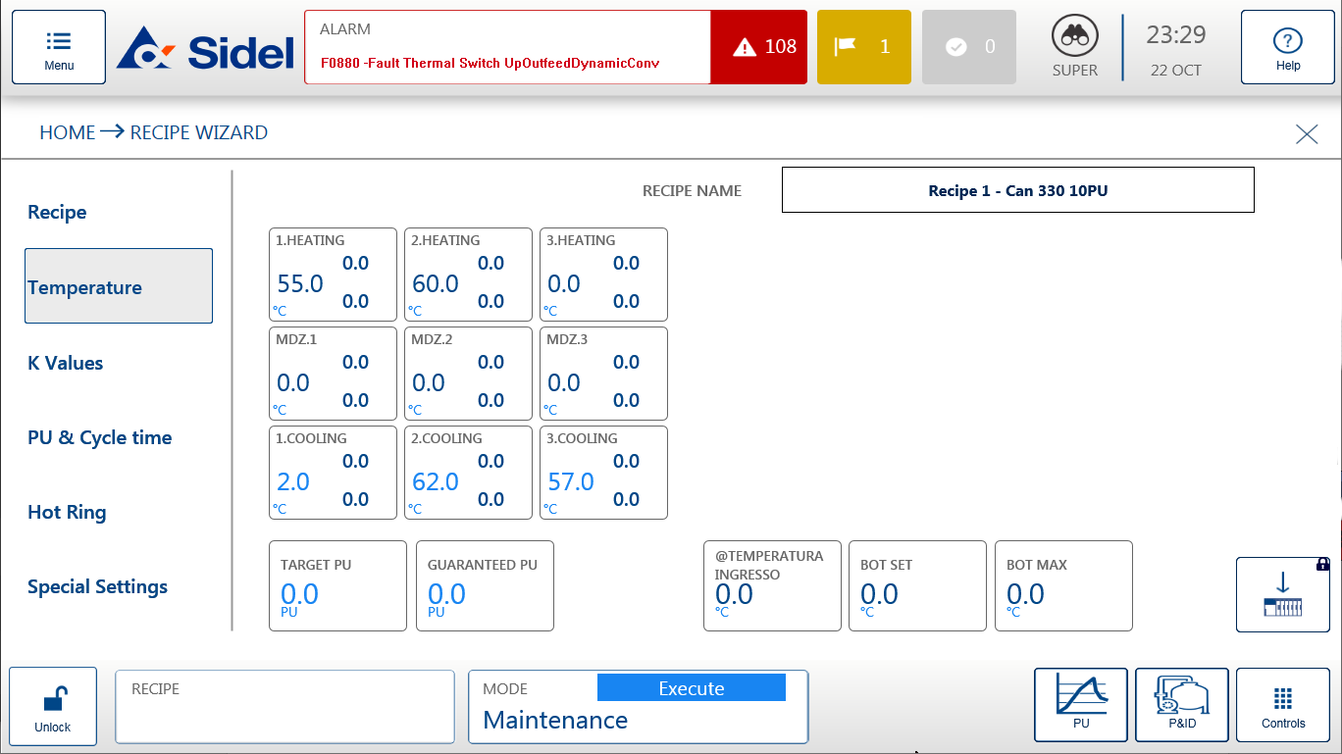
Prince E – PU control system
Sustainability, Quality, Obsolescense
O&U Ref – VRP-027
KEY FIGURES
Budget price:
BENEFITS
DESCRITPION
Improved pasteurization quality
60-80 K€*
Maximum control of the PU accumulated by the product for the best product quality
  No underpasteurisation in any case
  Minimally overpasteurized
  Achievement of the killing effect
Predictive approach minimizes spray temperature corrections for saving of steam/SHW up to 5% and of fresh water up to 15%
Complete user-friendly reports on pasto functioning to check performance and malfunctions
Electrical energy saving with automatic pumps switch off during long machine stoppages
Dynamic level control to optimize the cooling effect
Automatic fast product changeovers contribute to flexibility and water and steam savings
Optimized first heating up
Pre-arragement for Evo-On
Installation of a new HMI with new control software and new CPU Siemens 1500 Series
Modification on the overflow and balancing system to automatically control the water level
Payback estimation:
2 - 3 yrs
Installation time:
8 days
Machine downtime:
User friendly reporting and recipes modification
6 days
*Installation excluded
Can be combined with:
Machine application:
All Sidel pasteurizers
Competitors machines

