Slide 1
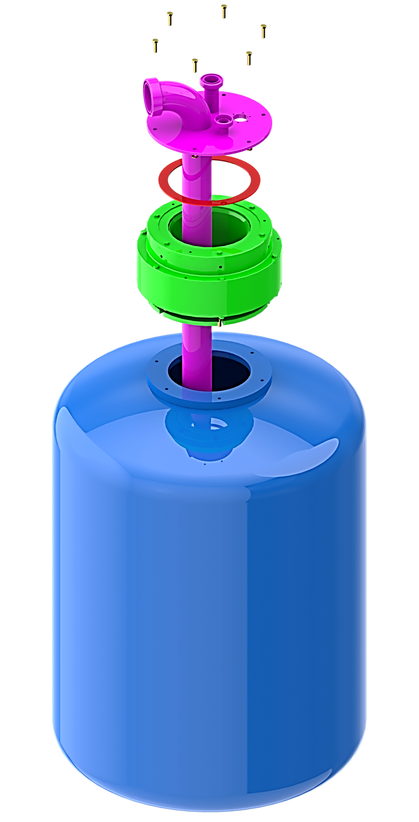
Reduce your maintenance cost and secure equipment efficiency
New Upper Manifold
VALUE AND BENEFITS
DESCRIPTION
Seal durability of 6000h instead of 3000h currently
Reduced product seal wear
Increased efficiency by reducing maintenance stops
The new design of the upper manifold allows a reduction in the maintenance time interval and less machine downtime; the gaskets durability is increased.
The balls are lubricated by a greasing nipple to optimize their operation and lengthen their lifetime.
Value: Maintenance, Efficiency
Equipment: Filler Europa WM
Catalogue code: SF017

