Slide 1
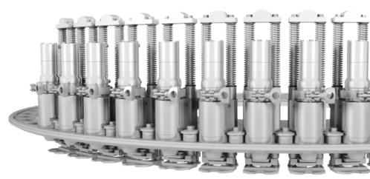
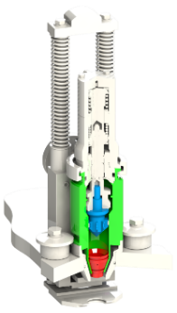
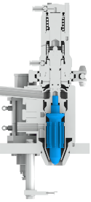
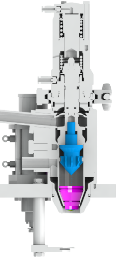

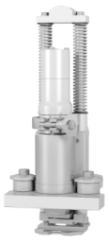


Increase Performance and Hygiene
New RFI Valve Nozzle
VALUE AND BENEFITS
DESCRIPTION
Faster valve opening and closing;
Less stress on wear parts;
Elimination of the spilling / splashing during filling;
Dry and clean filler during filling;
Laminar flow, it limits foaming;
No waste of product;
Minor bottles waste at the machine outfeed;
Improvement of the valve repeatability:
Sigma 2 with 500 ml bottle size.
The new plunger design, significantly lightened, improves the valve performance in the transitory phases of opening and closing. The new geometry of the plunger prevents the deformation of the valve body.
The innovative eccentric terminal allows filling with a laminar flow, creating less bubbles during filling. Moreover, it allows a precise and clean direction of the product jet, preventing leakages during the filling phases.
The insertion of the eccentric terminal eliminates the spilling and splashing phenomenons during the filling phases, making the flow very laminar.
Current
solution
New
solution
Eccentric terminal
New Plunger
Value: Efficiency, Product quality
Equipment: Filler Eurotronica FM-S RFI
Catalogue code: SF040

