Slide 1



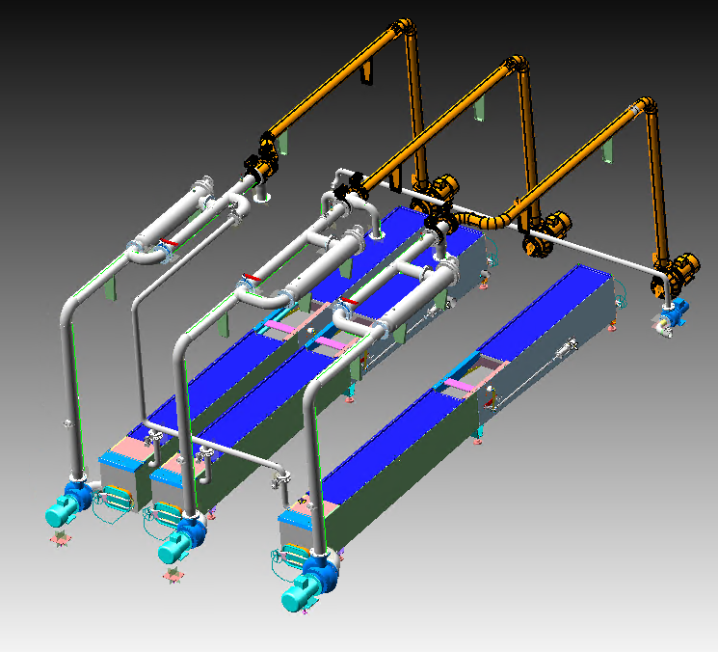
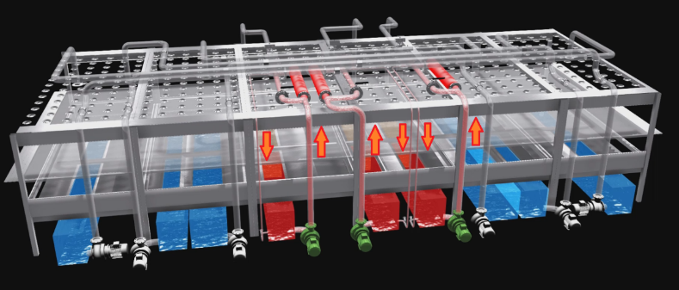
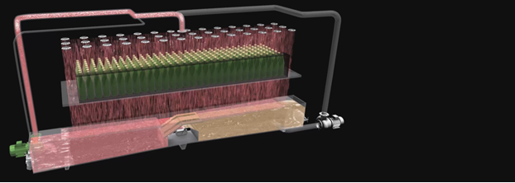
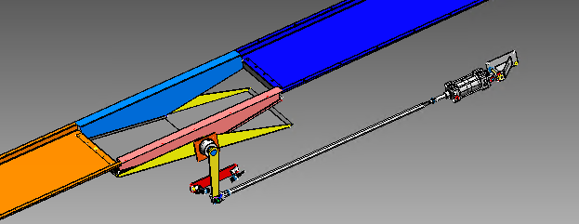
SWING on C Series – VRP-024
Sustainability, Quality, Obsolescense
O&U Ref – VRP-024
KEY FIGURES
Budget price:
BENEFITS
DESCRITPION
Improved pasteurization quality
150-200 K€*
Water and steam saving with improved energy and water management during control phases
Product Quality: Improved PU control with more reactive system
Lower TCO: Thanks to lower energy and water consumption (up to 10% steam and 20% water)
Application of the SWING technology to a traditional Sidel pasteurizer to improve PU control phase minimizing the usage of heat and water for this scope.
Replacement of the existing central tanks with new ones equipped with Swing® System
New piping and pumps for the central zones
Payback estimation:
5 yrs
Installation time:
14 days
Machine downtime:
SWING flap for optimized energy management
10 days
*Installation excluded
Can be combined with:
Prince E
Machine application:
C Series Pasteurizers

