Slide 1



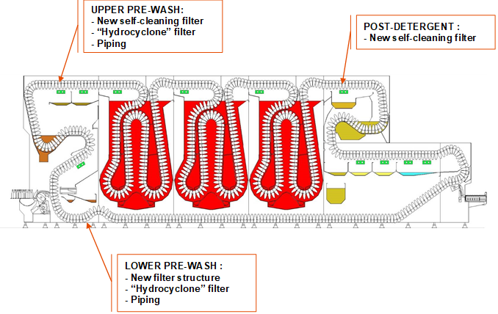
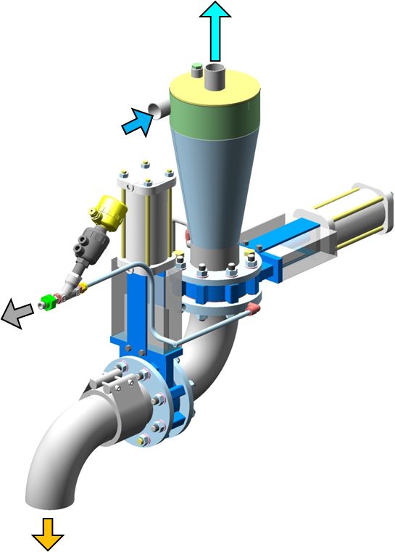
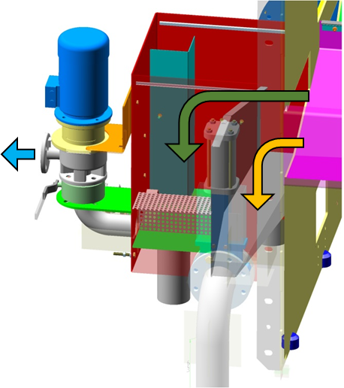
Sand package for Bottlewashers
Quality
Maintenance
O&U Ref – VRB-XXX
KEY FIGURES
Budget price:
BENEFITS
DESCRITPION
Installation of hydro-cyclone, new filter mesh and, as an option, a detergent tank continuous filtration system to extract sand and solid particles from the process water.
40-60 K€*
Maintenance
Reduction ordinary maintenance times (Spray, filter groups,…)
Safety and ergonomics
No manual operation during production (operator safety)
Reduced exposure risk to caustic solution for daily cleaning
Flexibility
Maintenance and cleanings Savings (Filters, Sprays, …)
Productivity
Reduction of dirt/sand suspended in the tanks.
Improved water quality in the rinse tanks.
The “Hydro-cyclone” filtration is designed for :
Remove sand before the spray group, to avoid their clogging.
Self-cleaning function
Filter cleaning time programmable from HMI
Installation of new detergent filter unit, piping and automatic valves.
Detergent filter designed for automatic filtration of the caustic soda solution in the detergent baths during production.
Automatic operation set through HMI
Payback estimation:
TBD yrs
Installation time:
5 days
Machine downtime:
3 days
*Installation excluded
Can be combined with:
External caustic filtration
Machine application:
Hydra Bottlewashers
Oceano Bottlewashers

