Slide 1



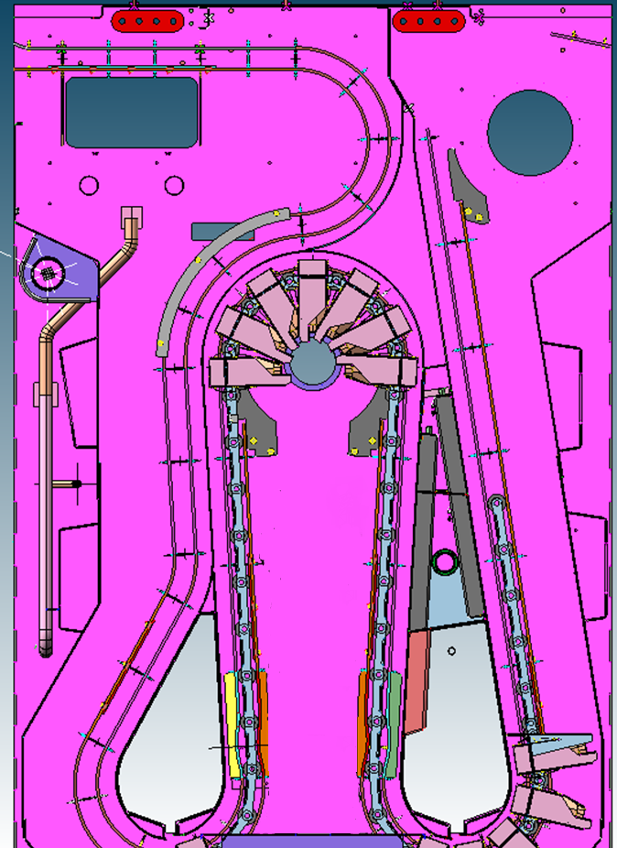
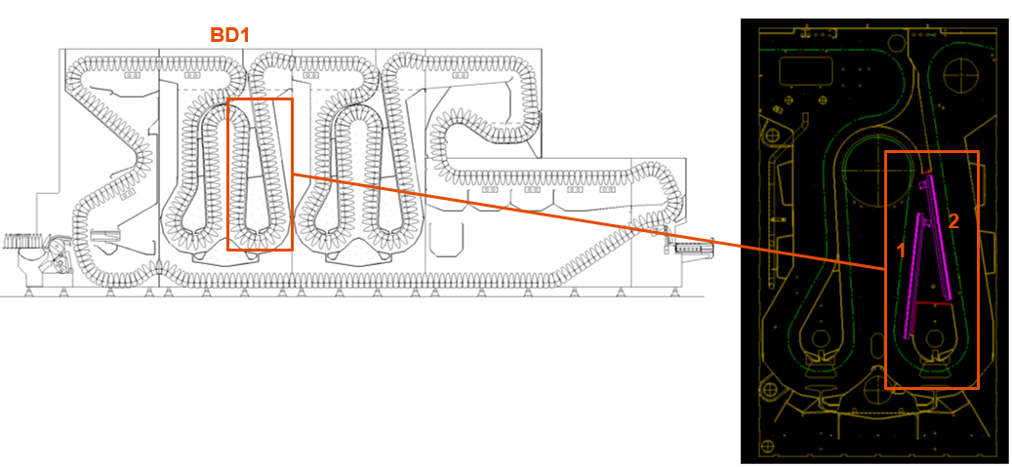
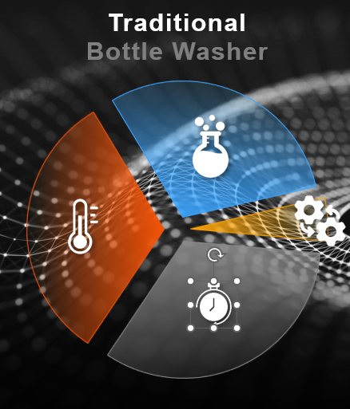
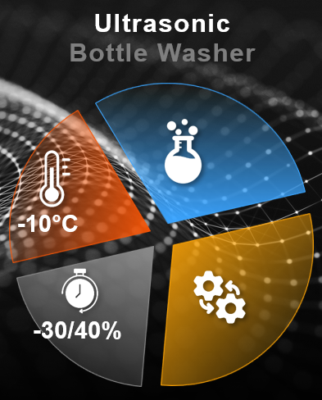
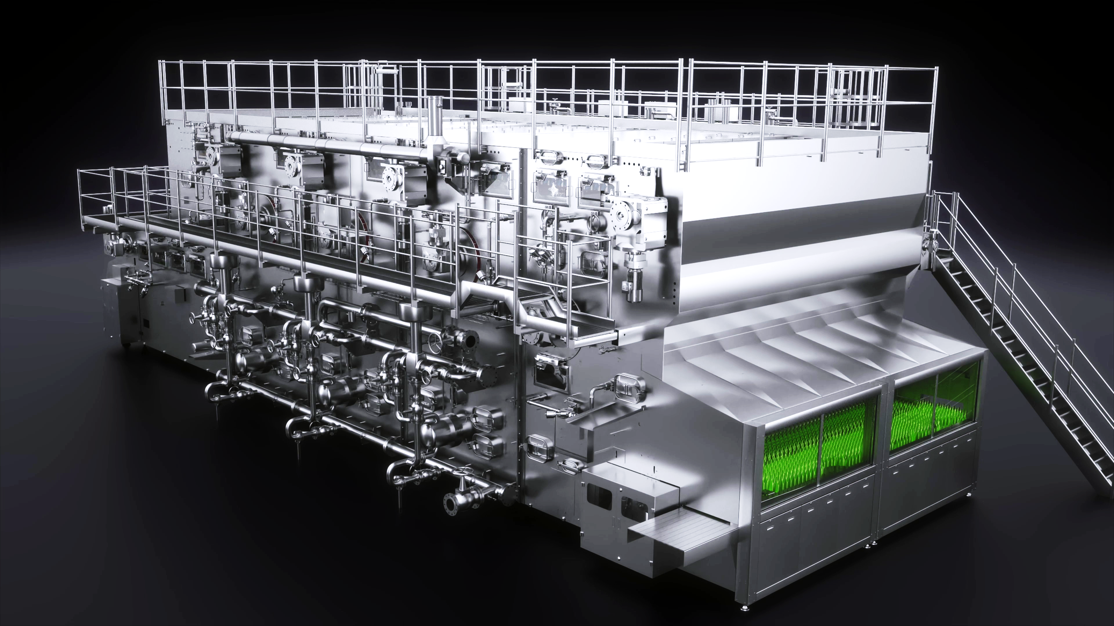
Ultrasonic application on Bottlewasher
Sustainability
Energy saving
O&U Ref – VRB-054
KEY FIGURES
Budget price:
BENEFITS
DESCRITPION
Installation of the plates into the first detergent module
250-300 K€*
Reduced washing Temperature: Caustic solution temperature reduction au to 65°C from 80°C
Energy saving: reducing washing temperature we can reduce up to 30% the energy required for the washing process
Water saving: Less water needed to cool down the bottles (up to 10% water saving)
Possibility to use heat pumps to heat up the machine: with reduced washing temeprature, steam can be replaced by hot water at 80°C generated by neans of het pumps
Reduction of the rejection rate: adding the mechanical effect of the ultrasonic waves to the washing process, we can imporve the washing efficiency reducing the rejection rate ad increasing the line performance.
Installation of ultrasonic plates into the first detergent tank
Payback estimation:
5 yrs**
Installation time:
12 days
Machine downtime:
10 days
*Installation excluded
**Considering a mediuma size BW and T reduction > 15°C
Can be combined with:
Machine application:
Hydra Bottlewashers
Oceano Bottlewasher
NDE Bottlewasher

