Slide 1
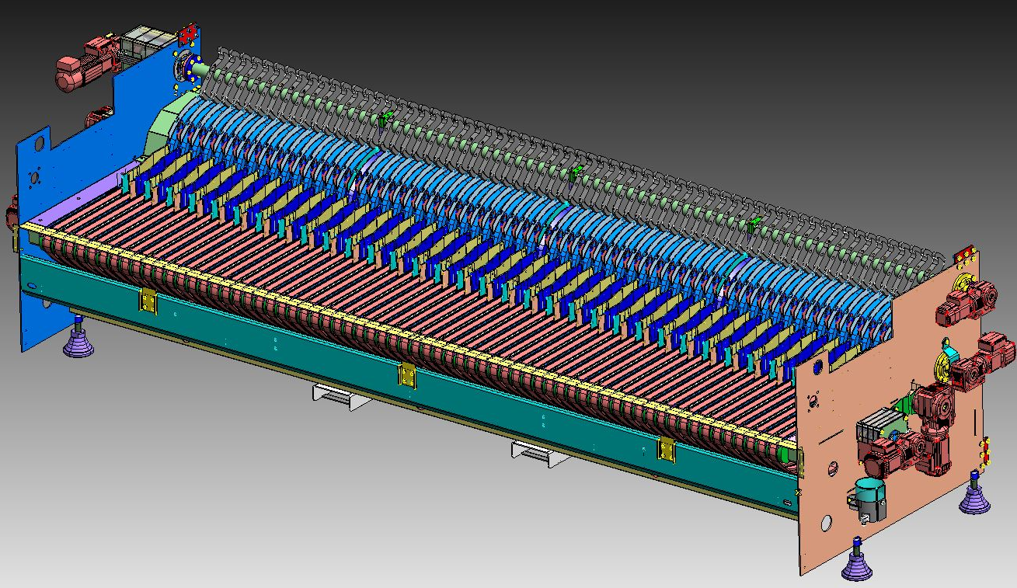
Increase equipment efficiency up to 0,3% and reduce maintenance cost
High Speed Infeed System
VALUE AND BENEFITS
DESCRIPTION
Reduction of maintenance cost (spare parts+ intervention) up to 60%
i.e. Bottlewasher HD-ht 95-140/46
Original Infeed System → 50 k€/year
High Speed Infeed System → 20 k€/year
Maintenance saving → up to 30 k€/year
Resetting safeties with gearmotors and not manually, shortening recovery times and increasing efficiency up to 0,3%
i.e. Bottlewasher “Oceano” efficiency 80% with 15% of total
downtime due to bottle broken/fallen at the infeed
Efficiency → up to +0,3%
Low skills required for the technicians involved in maintenance/overhaul operations
Elimination of risk of lack of spare part supplies for the load because these are obsolete.
Protection against overloads by pneumatic torque limiters
Possibility of adjusting the speed of the infeed belts for the various sizes directly from the control panel.
Replacement of loading unit with a simpler new model and with less wear parts
The system also includes a pneumatic safety system on both main shafts
The position is restored by the action of dedicated gearmotors
The conveyor belts feeding the bottles to the inserter fingers are operated by a special gearmotor with inverter.
Load shafts drive by means of toothed belt
Value: Efficiency, Maintenance, Flexibility, Obsolescence, Safety & Ergonomy
Equipment: Oceano, HD, Atlantic, RIO, NDE
Catalogue code: VRB-013

