Slide 1
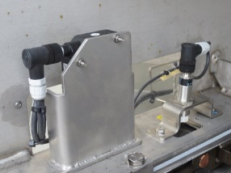
防止意外停机
链条磨损传感器
价值和益处
描述
Constant control of chain wear
Keep the control on intervention schedule for chain replacement
Wear Laser Sensor
Chain Pitch Sensor
Installation of sensors to measure the chain wear
价值：维护, 改善安全和人体工学性
设备： Oceano, Hydra, Atlantic,HD, Asia, Aqua, NDE (also in competitor machine)
产品目录代码：VRB-047

