Slide 1
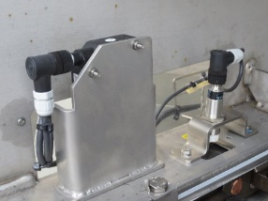
Verhindern Sie unerwartete Abschaltungen
Kettenverschleißsensor
NUTZEN UND VORTEILE
BESCHREIBUNG
Reduction of maintenance cost (spare parts+ intervention) up to 60%
i.e. Bottlewasher HD-ht 95-140/46
Original Infeed System → 50 k€/year
High Speed Infeed System → 20 k€/year
Maintenance saving → up to 30 k€/year
Resetting safeties with gearmotors and not manually, shortening recovery times and increasing efficiency up to 0,3%
i.e. Bottlewasher “Oceano” efficiency 80% with 15% of total
downtime due to bottle broken/fallen at the infeed
Efficiency → up to +0,3%
Low skills required for the technicians involved in maintenance/overhaul operations
Elimination of risk of lack of spare part supplies for the load because these are obsolete.
Protection against overloads by pneumatic torque limiters
Possibility of adjusting the speed of the infeed belts for the various sizes directly from the control panel.
Ständige Kontrolle des Kettenverschleißes
Behalten Sie die Kontrolle über den Interventionsplan für den Kettenaustausch
Wear Laser Sensor
Chain Pitch Sensor
Einbau von Sensoren zur Messung des Kettenverschleißes
Nutzen: Wartung, Sicherheit und Ergonomie
Ausstattung: Oceano, Hydra, Atlantic,HD, Asia, Aqua, NDE (also in competitor machine)
Katalog-Code: VRB-047

