Slide 1
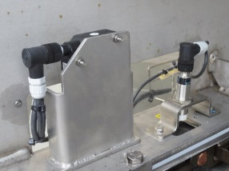
Prevent unexpected shutdowns
Chain Wear Sensor
VALUE AND BENEFITS
DESCRIPTION
Constant control of chain wear
Keep the control on intervention schedule for chain replacement
Installation of sensors to measure the chain wear
Wear Laser Sensor
Chain Pitch Sensor
Value: Maintenance, Safety & Ergonomy
Equipment: Oceano, Hydra, Atlantic,HD, Asia, Aqua, NDE (also in competitor machine)
Catalogue code: VRB-047

