Slide 1

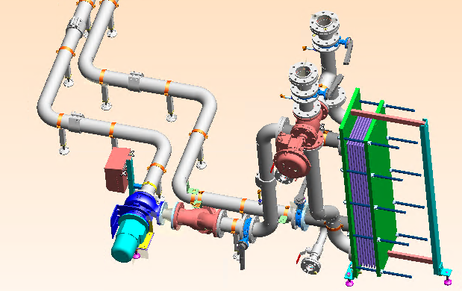
Reduce your water consumption up to 70%
Cooling System
VALUE AND BENEFITS
DESCRIPTION
Using cold fluid for saving of fresh water up to 70%.
i.e. Cooling system with Cooling Tower installed in
pasteurizer 72,000bph – 440ml
Line efficiency → 60 %
Average water (15°C) consumption → 6 m3/h
Water saving with cooling system → 4,2 m³/h
Control of product temperature at the machine outfeed customised by each recipe for best product quality.
External installation of circuit to supply the plates heat exchanger and implementation of all the connections necessary for its working.
The system is designed for cooling the waters meant for spraying of the product cooling areas of the machine.
Software update.
Value: Sustainability, Product quality,
Equipment: All pasteurizer (also in competitor machine)
Catalogue code: VRP-012

