Slide 1
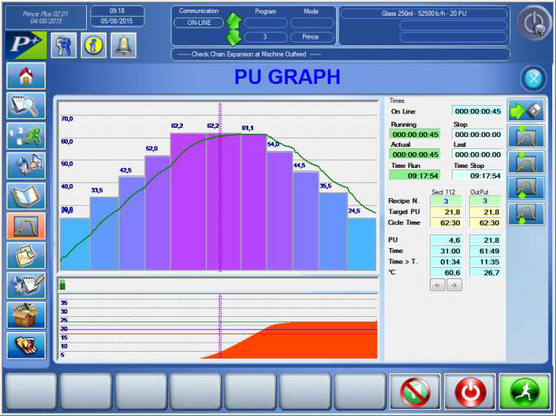
Reduce water and vapor consumption on your equipment
PRediction IN Control Equation – Plus control system
VALUE AND BENEFITS
DESCRIPTION
Maintenance
Routine maintenance operations made easier
Safety and ergonomics
List of alarms and messages.
Easy machine operation using the control panel.
Personal “PSWD” with different functionality.
Productivity
Reduction of mains water supply consumption costs.
Reduction of vapour consumption costs.
Flexibility
Possibility of deploying “AT FLIGHT” format change.
Possibility of setting functionality parameters of the machine.
Efficient control of “PU” pasteurisation unit :
NO under-pasteurised product
Minimum accumulation of “PUs” ensured, defines and limits over-pasteurisation
Achievement of “Killing Effect”
Efficient control of product outfeed temperature
Function can be easily set
Accuracy of recipe setting for each size.
Production data acquisition
Clear and exhaustive reports.
Value: Efficiency, Cost optimization, sustainability
Equipment: Pasteurizer
Catalogue code: VRP-023

