Slide 1
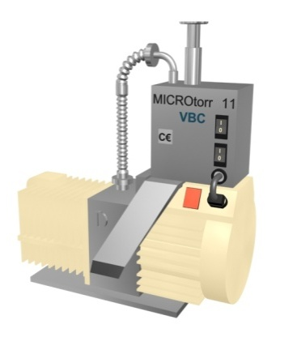
Reduce your consumption of gaseous nitrogen by up to 70%, reduce the weight of your preforms
Liquid nitrogen injection
VALUE AND BENEFITS |  | DESCRIPTION
Decrease in nitrogen consumption. Reduction in oxygen residual. Greater bottle rigidity. Improvement in palletization. Makes bottle labeling easier. Possibility of reducing the preform weight. |  | Replacement of the inertia tunnel with a liquid nitrogen injection system.
Value : Product quality, Cost Optimisation
Equipment : Aseptic fillers (FMi)
Catalogue code : FOR044

