Slide 1
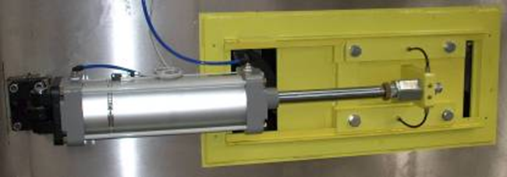
Optimized tension of the main chain in the return zone
Automatic chain tensioner
VALUE AND BENEFITS |  | DESCRIPTION
Easy installation Optimized tension of the main chain in the return zone Automatic detection of the need for chain tensioning maintenance |  | The upgrade consists in adding an automatic tensioner system in the return zone under the machine
Value: Product quality
Equipment: Oceano, NDE
Catalogue code: B018

