Slide 1
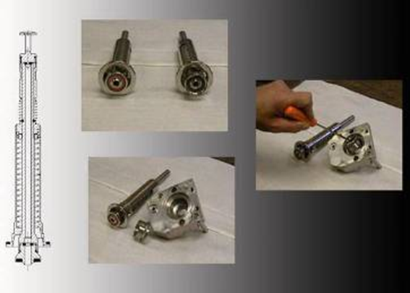
5% more productivity for 2 Liters bottles
Super high flow (SHF) filler valve internal component
VALUE AND BENEFITS |  | DESCRIPTION
Faster filling 5% extra productivity for 2-L bottles |  | Internal component with 7mm air return for fillers processing bottles of 1 liter or more. 5% over speeds obtained with HF valves. Internal configuration with increased air return and elimination of valve siphoning. Parts affected: Internal component Pressurization valve Valve support
Value: Efficiency
Equipment: Fillers
Catalogue code: HS018

