Slide 1
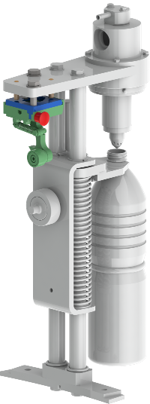
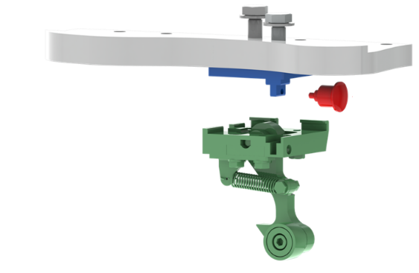
Increase machine efficiency and reduce maintenance cost
New quick-change trolley
VALUE AND BENEFITS
DESCRIPTION
Reduction of maintenance time and complexity
Less intervention time in case of failure
The new trolley is fitted with a quick-change system which enables fast and easy substitution of the roller.
Value: Cost optimization
Equipment: Fillers Europa WM - RFE
Catalogue code: SF034

