Slide 1
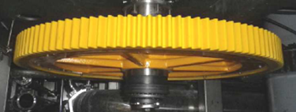
Reduce maintenance costs and machine downtime
Torque Limiter on Outfeed Starwheel
VALUE AND BENEFITS |  | DESCRIPTION
The new system prevents the transmission of overtorque and thus reduces the risk of costly repairs and machine downtime caused by overloads. It also limits the destructive energy accumulated in the system by up to 90% No need for maintenance on the coupling Safety couplings increase equipment efficiency and productivity |  | The current solution without torque limiter may lead to costly repairs and machine downtime due to overloads The new solution features a new command with torque limiter and longer shaft
DESCRIPTION
Value: Efficiency
Equipment: Aseptic fillers (FMa)
Catalogue code: SP001

