Slide 1
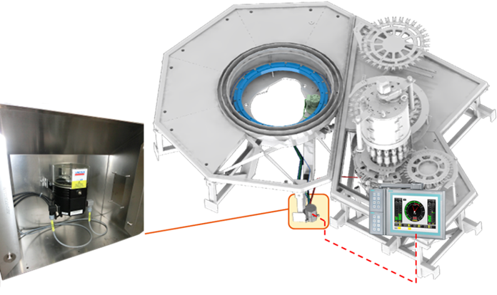
Eliminate costly downtime for lubrication and preserve equipment efficiency
Central automatic lubrication system
VALUE AND BENEFITS |  | DESCRIPTION
Reduced maintenance times: On average, 30 minutes for every 1,500 production hours Remove risk associated with build-up of grease on moving parts Preserve equipment efficiency |  | The automatic lubrication system eliminates the risk of moving parts on the filler which have not been lubricated, thus fully complying with Sidel best-practice operation guidelines The system is managed by the machine PLC which lubricates various points on the machine at preset intervals on the basis of machine rotation time Manual lubrication can be performed in the event of a PLC fault
DESCRIPTION
Value: Efficiency
Equipment: Aseptic fillers (FMa)
Catalogue code: SP002

