Slide 1
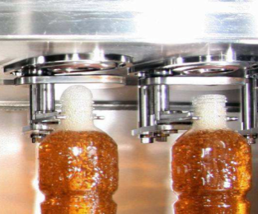
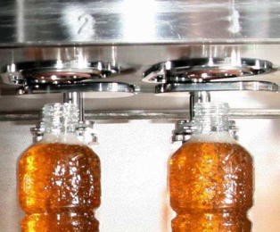
Reduce product flow deviation
Upgraded plungers on filling valve to reduce flow deviation
VALUE AND BENEFITS |  | DESCRIPTION
Reduced product flow deviation Increased neck rinsing Limited risk of product residue on neck |  | The current solution with valve body and plungers was designed to limit foaming on the neck The new solution improves it even more thanks to a valve body with a smaller outlet to decrease flow deviation
DESCRIPTION
Value: Product Quality, Cost Optimisation
Equipment: Aseptic fillers (FMa)
Catalogue code: SP005

