Slide 1
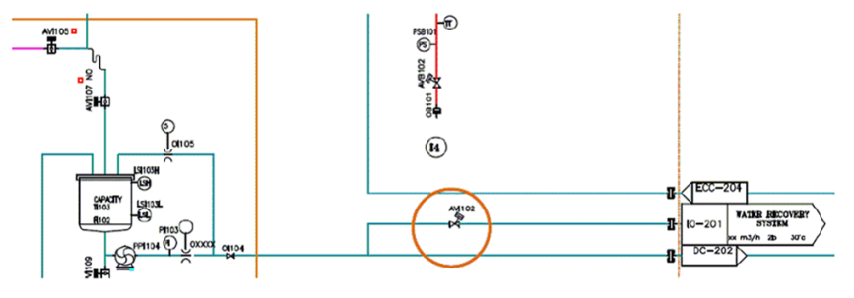
Reduce process water waste by reusing bottle washer effluent
Rinsing water recovery system
VALUE AND BENEFITS |  | DESCRIPTION
Reuse bottle washer water waste as service water → up to 50% of rinser consumption Collect the water coming out of the bottle washer into a dedicated tank |  | The purpose is to give you the possibility to reuse the water used to rinse bottles instead of throwing it away The recovered water can be used as service water (e.g. washing of machines) or reconditioned via active carbon installations. It cannot be reused as process water because the recovered water contains traces of peracetic acid (PAA)
Value: Cost Optimisation, Sustainability
Equipment: Aseptic fillers (FMa)
Catalogue code: SP008

