Slide 1
Improving health and safety in the workplace
Line Improvement: ref. #1052 ejection chute and basket for MM GM Universal (SBO 10-14-16-20)
Sidel Services

Slide 2
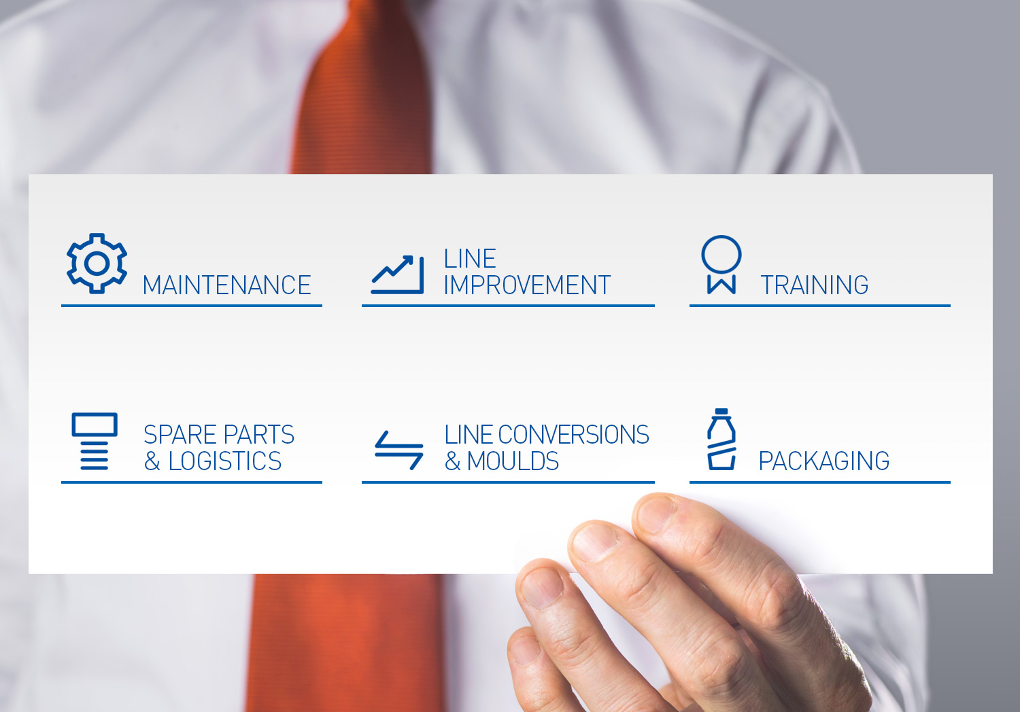
Service package: all you can need!

Slide 3
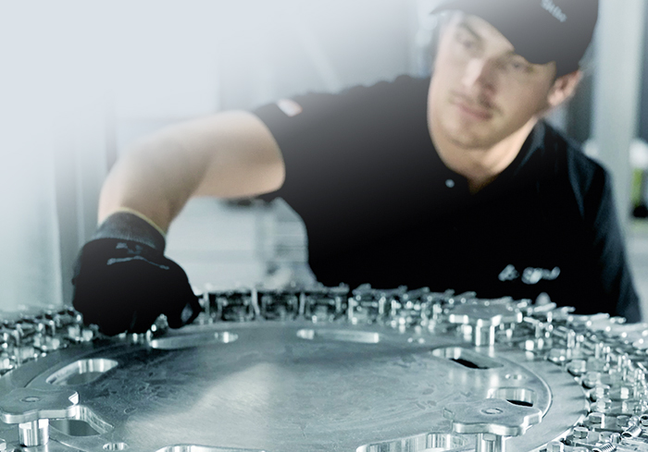
Line improvement Time to increase your resource efficiency
The full package
Options
Upgrades
Remote data analysis
Line audits
Second-hand equipment

Slide 4
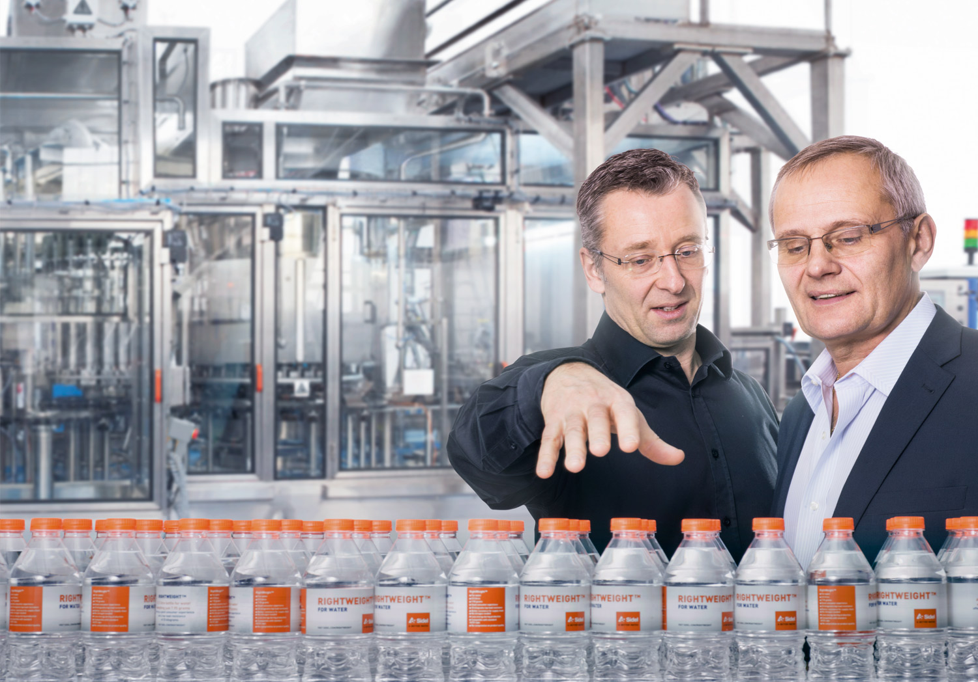
Sidel Options & Upgrades Made for you and your line
OPTIONS & UPGRADES
Boost product quality
Increase efficiency
Reduce Total Cost of Ownership (TCO)
Future-proof your productivity

Slide 5
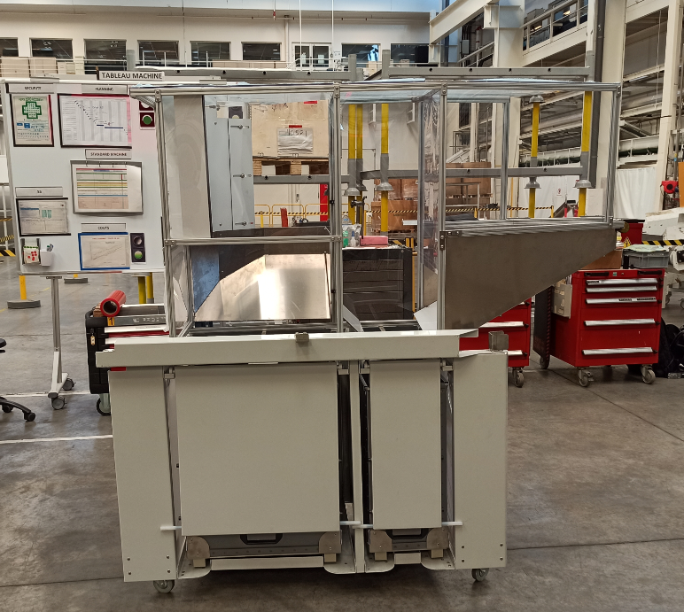
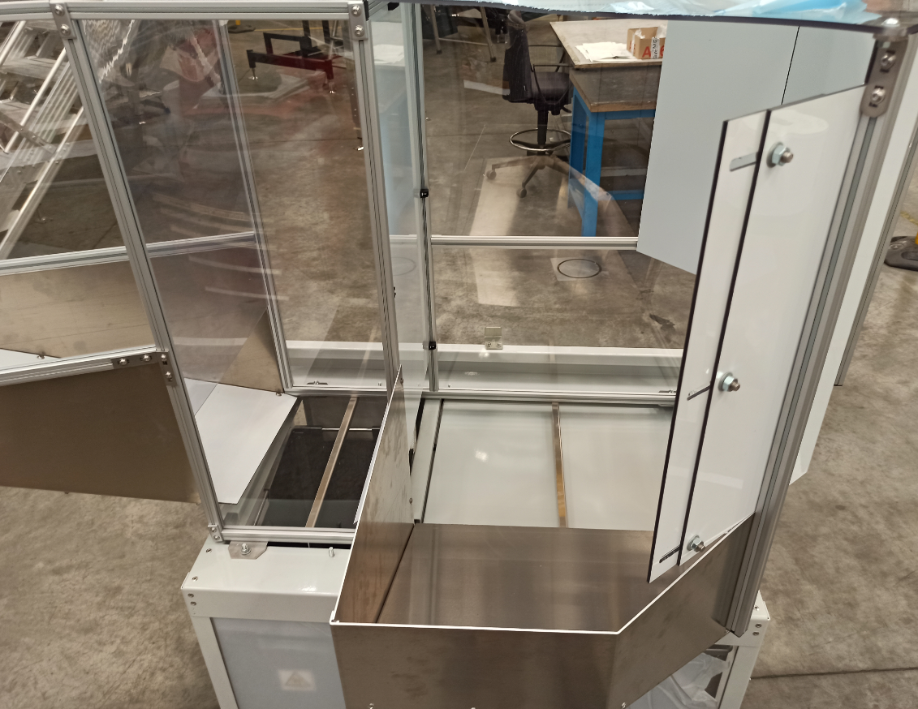
1052: ejection chute and basket for MM GM Universal (SBO 10-14-16-20)
Improving health and safety in the workplace
VALUE AND BENEFITS
DESCRIPTION
Matrix latest solid material replaces the nets
Chute can be cleaned
Robust design
Design compatible with dedusting option
Basket easier to remove and handle
Main components can be dismantled and replaced easily
Better safety: anti-intrusion bar in the baskets
Easier access to the transfer table once removed
New chutes
New baskets
Preform and bottle hatch
Collector
Value: Efficiency
Equipment: Blower MM GM Universal
Catalogue code: 1052

Slide 6
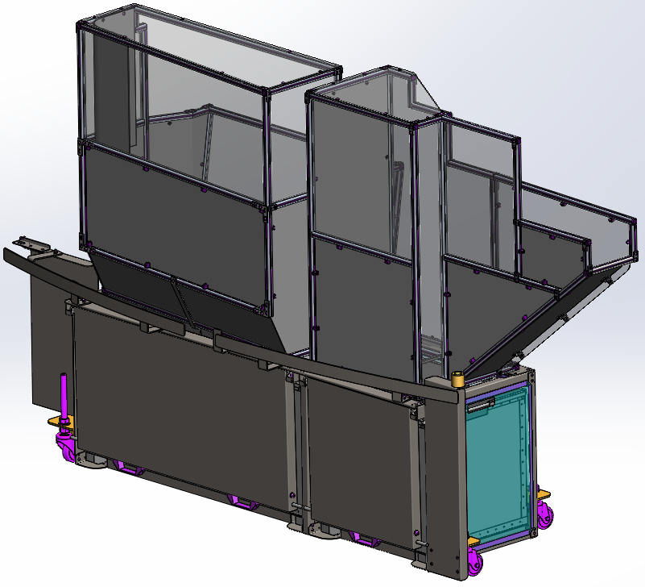
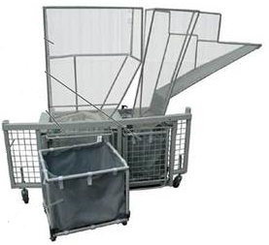
Ejection chute and basket for MM GM Universal (SBO 10-14-16-20): evolution

Slide 7
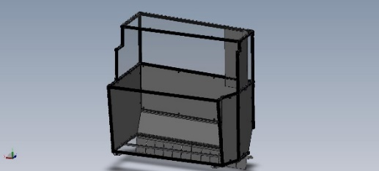
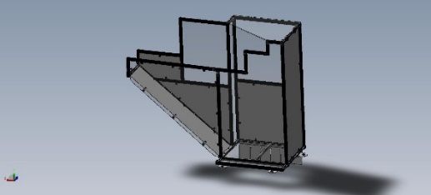
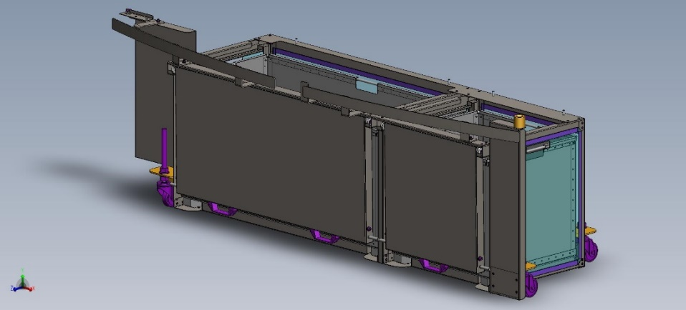
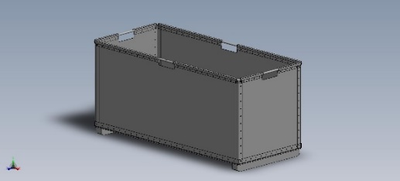
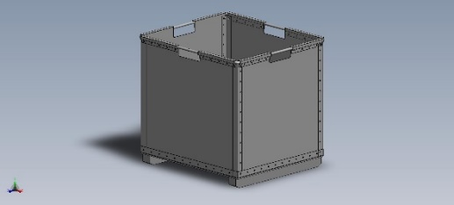
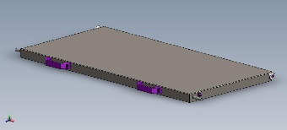
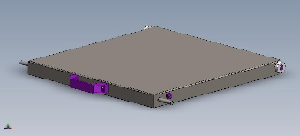
Bill of material:
Bottle chute
Preform chute
Collector
Bottle basket
Preform basket
Bottle hatch
Preform hatch

Slide 8
Ejection chute and basket for MM GM Universal
TECHNICAL OVERVIEW
Ease of implementation | 1/3
Machine application exclusion? | today: PM and TM are not part of the perimeter
Mandatory option needed? | no
Targeted sub-assembly | Preform and bottle ejection at transfer
Diagnostic visit and/or equipment refurbishment needed before upgrade? | no
Time to install upgrade | 1 day for one FSE mechanic
Sidel expertise needed? | yes
Average delivery time | tbd

Slide 9
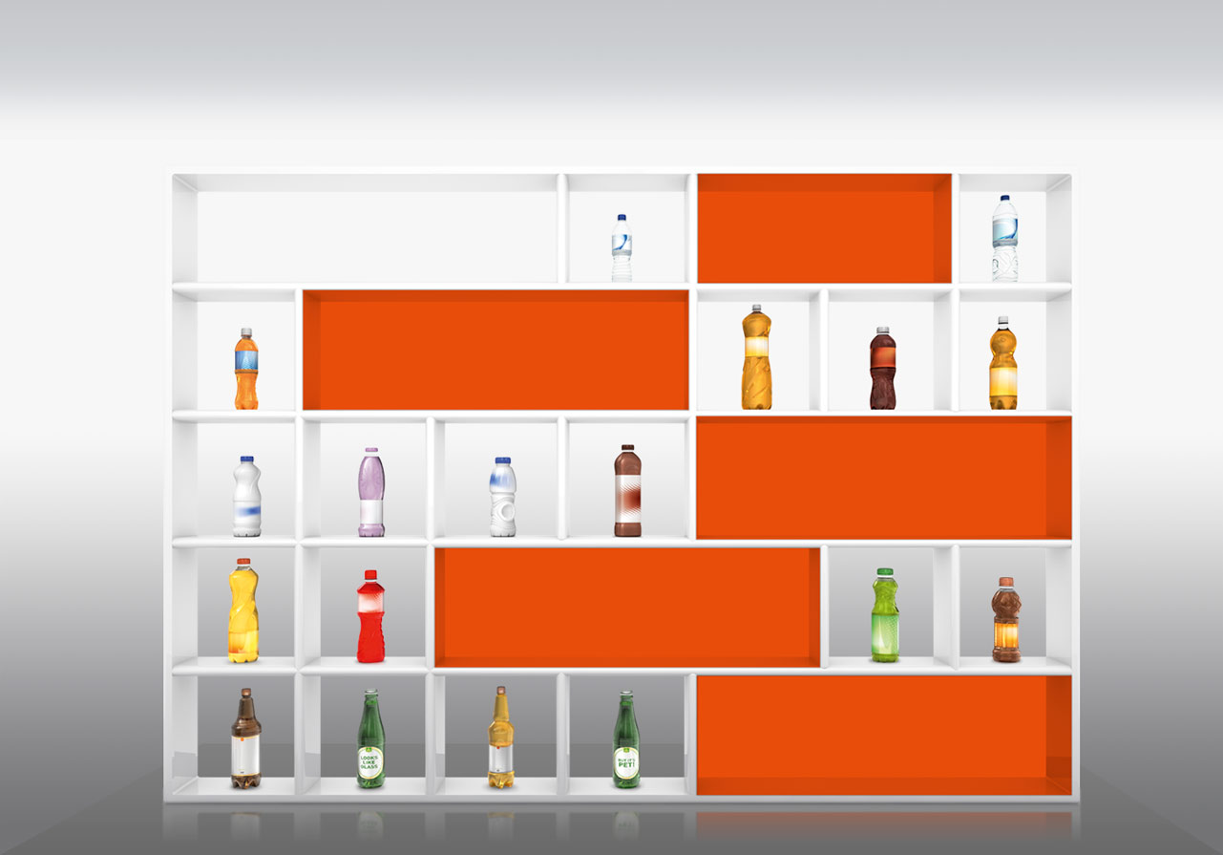
All market segments, always first served!
The right services for all beverage categories
WATER
CARBONATED SOFT DRINKS
LIQUID DAIRY PRODUCTS
JUICES, NECTARS, SOFT DRINKS, ISOTONICS AND TEAS
BEER

