Slide 1
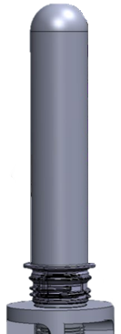
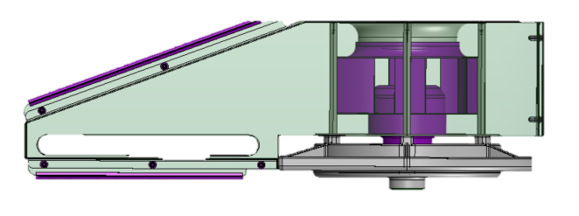
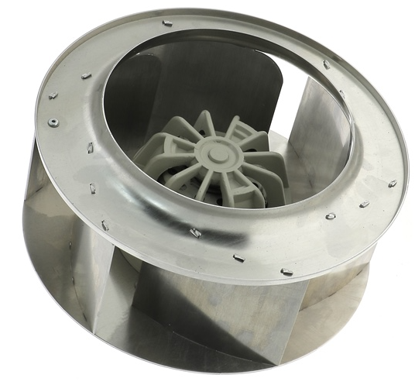
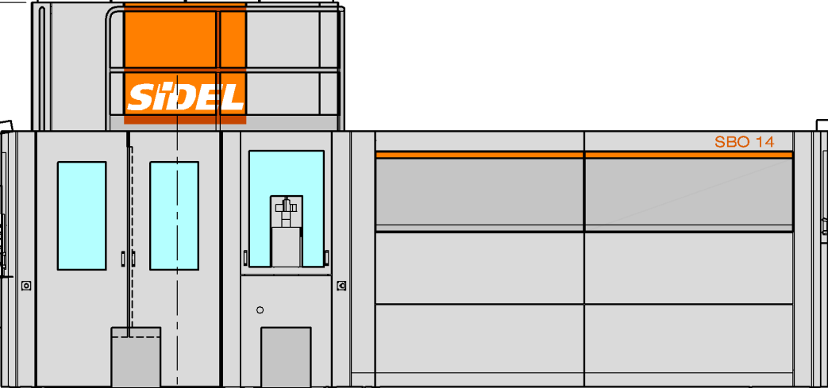
Neck finish under control
Neck ventilation at the end of the oven
VALUE AND BENEFITS
DESCRIPTION
Additional cooling of the preform neck finish with blown air.
Reduce the risk of having neck finishes overheating.
In some cases, it can ease the production of very technical bottles.
A centrifugal fan to be installed at the end of the oven, in the 180° bend.
Plugged on the spindle chain tensioner shaft.
Not suitable for oven equipped with neck indexing system.
Value: Product Quality
Equipment: Blower Series 2
Catalogue code: 993

