Slide 1
Neck ventilation at the end of the oven
Line Improvement: Blower Series 2
April 2023
Sidel Services

Slide 2
Service package: all you can need!

Slide 3
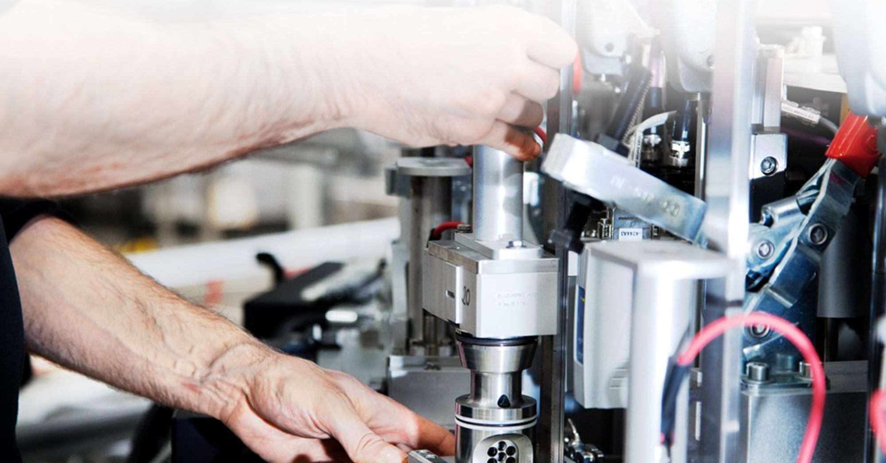
Line improvement Time to increase your resource efficiency
The full package
Options
Upgrades
Remote data analysis
Line audits
Second-hand equipment

Slide 4
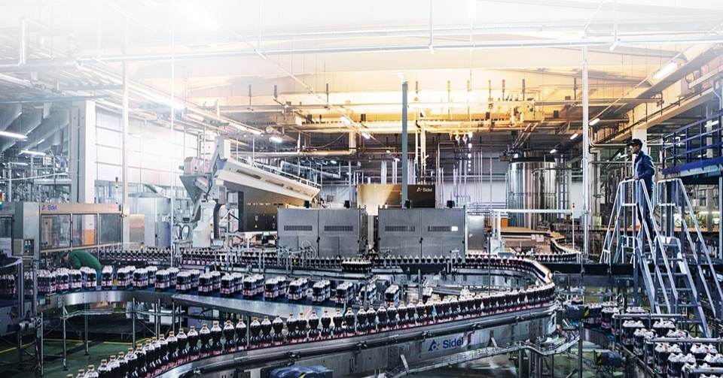
Sidel Options & Upgrades Made for you and your line
OPTIONS & UPGRADES
Boost product quality
Increase efficiency
Reduce Total Cost of Ownership (TCO)
Future-proof your productivity

Slide 5
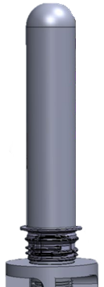
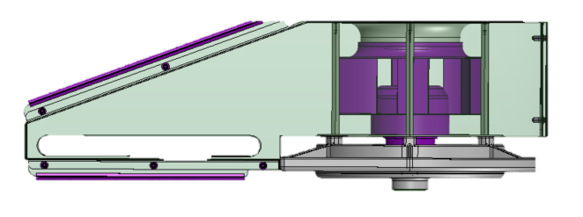
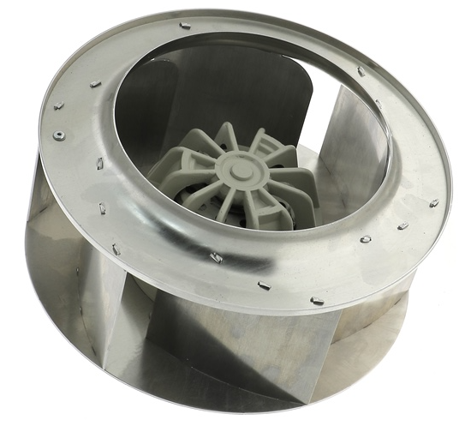
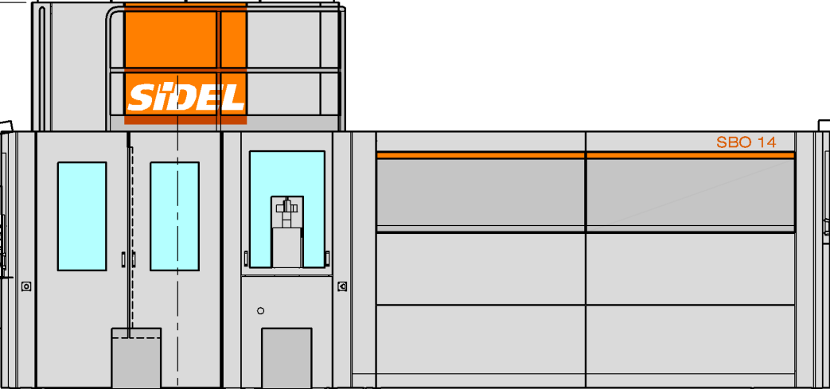
Neck finish under control
Neck ventilation at the end of the oven
VALUE AND BENEFITS
DESCRIPTION
Additional cooling of the preform neck finish with blown air.
Reduce the risk of having neck finishes overheating.
In some cases, it can ease the production of very technical bottles.
A centrifugal fan to be installed at the end of the oven, in the 180° bend.
Plugged on the spindle chain tensioner shaft.
Not suitable for oven equipped with neck indexing system.
Value: Product Quality
Equipment: Blower Series 2
Catalogue code: 993

Slide 6
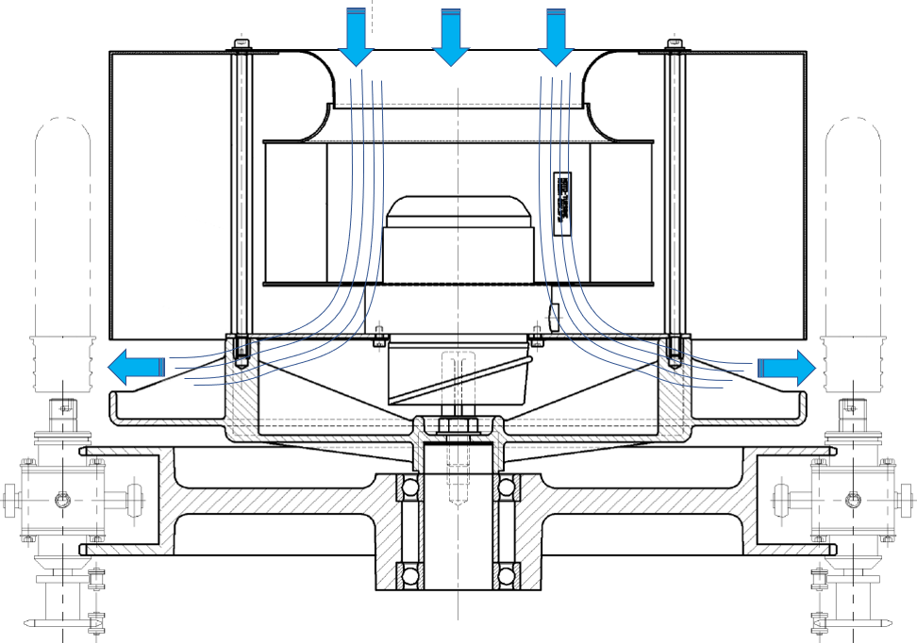
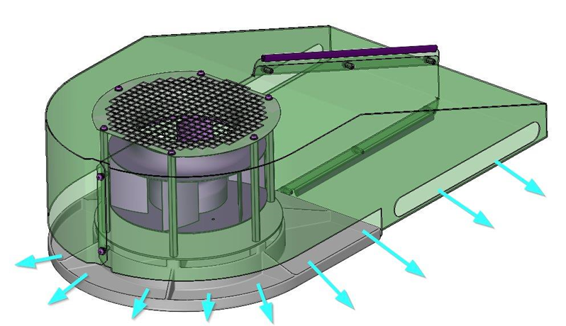
Neck ventilation at the end of the oven :
5
1
4
Centrifugal fan
Spindle chain tensioner shaft
Spindle chain tensioner wheel
Ventilation lower box
Ventilation upper box
3
2
Dwg: 01069943801

Slide 7
TECHNICAL OVERVIEW
Ease of implementation | 2/3
Machine application exclusion? | SBO Series 2
Mandatory option needed? | No
Targeted sub-assembly | Oven
Diagnostic visit and/or equipment refurbishment needed before upgrade? | No
Time to install upgrade | Approx 2 days
Sidel expertise needed? | Yes.
Average delivery time | TBC

Slide 8
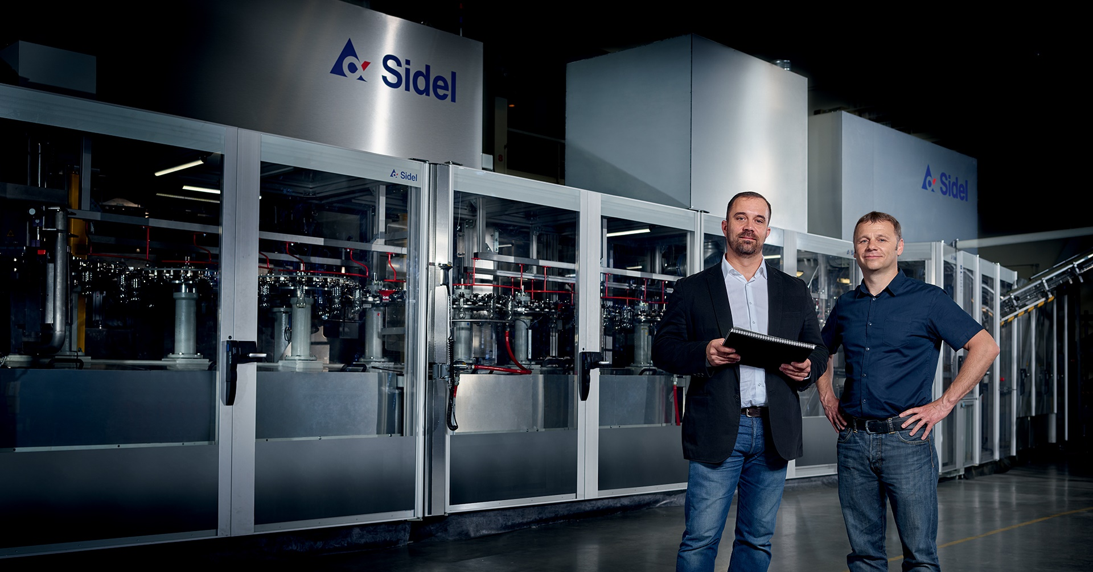
Contact your
Service Account Manager now

