Slide 1
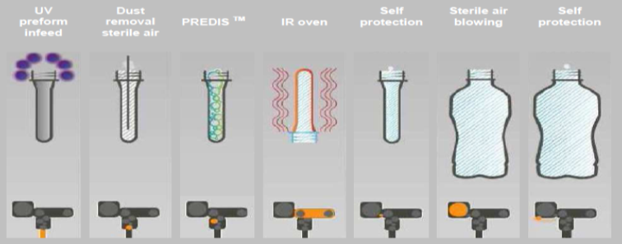
Improve the organoleptic quality of your sensitive product with lower carbon footprint
PredisTM C3 as O&U
VALUE AND BENEFITS |  | DESCRIPTION
Self protection due to H2O2 exhaust after activation and blowing phases Economical: Low consumption of chemical & energies: H2O2 consumption < 1l/h H2O2 residual < 0,5ppm Low maintenance and labor costs Simple solution to extend shelf life Ecological: Low power; no water consumption; no effluents; compact system Safe: 3log reduction guarantee (on bacillus Atrophaeus); 100% of bottles produced are decontaminated; exclusively with H2O2 from SOLVAY supplier Packaging: Possible light weighting; total freedom of shape |  | Easy integration of the five options in the existing configuration: UV rail Dedusting module Predis C3 module Extraction hood Blowing air filtration
Value: Product Quality
Equipment: Blowers Universal
Catalogue code: 1006

