Slide 1
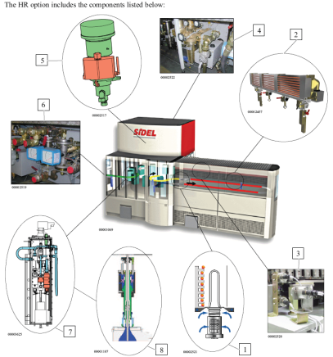
Produce bottle for sensitive products
HR Kit on Series2
VALUE AND BENEFITS |  | DESCRIPTION
H.R. (Heat Rresistant) option allows the manufacture of bottles being able to be subjected to the following particular constraints: Hot filling (up to 88 °C) without deformation. Conditioning Refill |  | The process which provides the bottles with these properties is known as ‘thermofixing’. Thermofixing increases the crystallinity of the article being produced and is obtained by associating the following two processes: Bi-orientation: the standard mechanical process by which a heated preform is stretched and blown. Heated molds: an optional thermic process which reduces the tensile stress produced in the articles by the bi-orientation process. The thermofixing process, i.e. the HR option, requires specific machine settings according to the bottle being produced: Higher oven temperatures: aerated spindle tips, independent cooling shields and extra infrared temperature sensors. Heated molds: a regulated oil circuit, interface panel and special rotary unions. Rapid item cooling and mold release assistance: air sweep system and 4-stroke nozzle
Value: Flexibility
Equipment: Series 2 blowers
Catalogue code: 511

