Slide 1
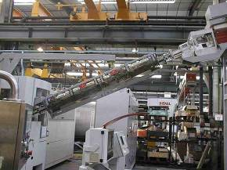
Increase hygiene level
UV Rail
VALUE AND BENEFITS |  | DESCRIPTION
The rail of feeding equipped with tubes UV allows a biological processing of the outside of the preforms and in particular of the neck |  | Replacement of the standard rail by a rail UV
Value: Product Quality
Equipment: Series 2 blowers
Catalogue code: 548

