Slide 1
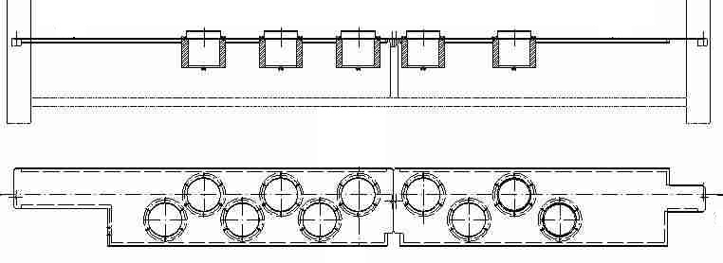
Reduce risk of bottle pollution
Air filtration on oven
VALUE AND BENEFITS |  | DESCRIPTION
This option installed in the oven, allows a filtration of the air being used for distribution of the preforms as well as cooling of the lamps, avoiding particles deposit |  | This option consists in installing gravimetric filters on the ventilators positioned under the oven; as well as filter cartridges on the ventilators being used for the infra-red cooling of the lamps
Value: Product Quality
Equipment: Series 2 blowers (SBO 2/3 - SBO 4/4 - SBO 4/6 - SBO 6/6 - SBO 6/10 - SBO 10FL - SBO 10/10 - SBO 10/14 - SBO 16 - SBO 24/24 - SBO 32/26)
Catalogue code: 556

