Slide 1
Reach 1,600 bottles per hour per mould (bphpm)
Speed up kit 1600 bphpm
VALUE AND BENEFITS |  | DESCRIPTION
Increase your production capacity through a limited investment. |  | Like for the 1530 bphpm speed up kit, the announced rate is a maximum mechanical rate valid only for standard processes (neither HR, neither Refill, nor PH) and fitted with cylindrical GUPM. A diagnostic visit has to be forecasted followed by a refurbishing. This upgrade will be performed only if the machines is back to its original conditions. Additional 1530 bhm kit for machine number lower than SBO PM 5227, SBO MM 5240, SBO GM 5259.
Value: Efficiency
Equipment: Series 2 blowers
Catalogue code: 951
Bottle drawing & mold weight/drawing necessary, otherwise guarantee on mechanical, not on process. Can not be fitted on CHP machines and machines with square GUPM

Slide 2
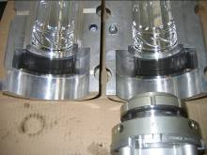
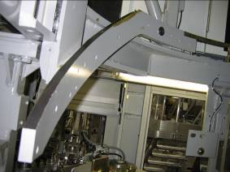

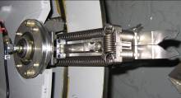
Reach 1,600 bottles per hour per mould (bphpm)
Speed up kit 1600 bphpm
DESCRIPTION – MAIN CHANGES
Mold
Base mold support
Specific wom mould washer
Cams
Stretching cam
Preforms and bottles transfer cam
Mould opening closing cam
Base mould raising cam
Mould locking cam
PLC
Eprom
Kinematics
Transfer arms
Value: Efficiency
Equipment: Series 2 blowers
Catalogue code: 951
Bottle drawing & mold weight/drawing necessary, otherwise guarantee on mechanical, not on process. Can not be fitted on CHP machines and machines with square GUPM

