Slide 1
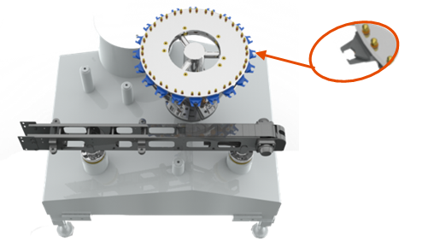
Decrease drastically change over time for PET bottles and improve cleanliness of the filler
New grippers on outlet star wheels
VALUE AND BENEFITS |  | DESCRIPTION
No more format changeovers needed for PET bottles Maximum cleanliness of the machine base area |  | On the actual configuration, personnalisation parts are necessary to produce different sizes of PET bottles On the new configuration, no more personalization parts needed for guides and starwheels thanks to: An adjustable conveyor Grippers instead of guides and starwheels
Value: Flexibility
Equipment: Fillers
Catalogue code: HS070

