Slide 1
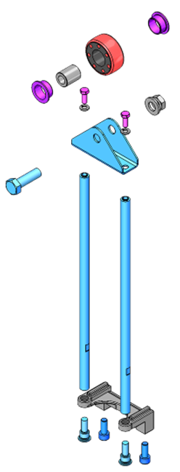
Reduce your maintenance time and costs
New Roller Carriage
VALUE AND BENEFITS |  | DESCRIPTION
Reduced maintenance (~ - 50%) Improved lifetime (~ 5000/6000 hours with good maintenance conditions) Improved hygiene Improved cleaning system Reduced costs |  | Prevent premature wear of the roller carriage No lubrication needs
Value: Efficiency
Equipment: Fillers
Catalogue code: HS071

