Slide 1
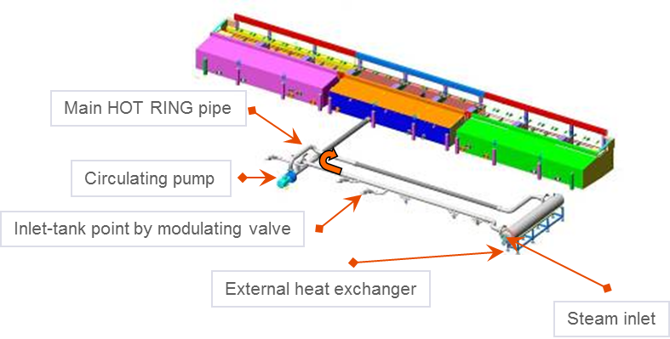
1 external heat exchanger for all spraying zones
“Hot Ring”
VALUE AND BENEFITS |  | DESCRIPTION
1 external heat exchanger for all spraying zones 1 steam inlet 1 modulating valve 1 condensate discharge Hot water at low pressure inside the “hot ring” Optimized steam consumption Increased heating system performance Precise control of the process temperature |  | 1 pump working continuously to create a “closed circuit” with hot water always at 80°C 1 external heat exchanger keeps the water hot in the circuit: 1 modulating valve 1 condensate discharge A modulating valve is included in each tank to inlet hot water and to heat the spraying zone The “hot ring” is thermally insulated
Value: Product quality
Equipment: Pama R, DR, DRDs
Catalogue code: P013

