Slide 1
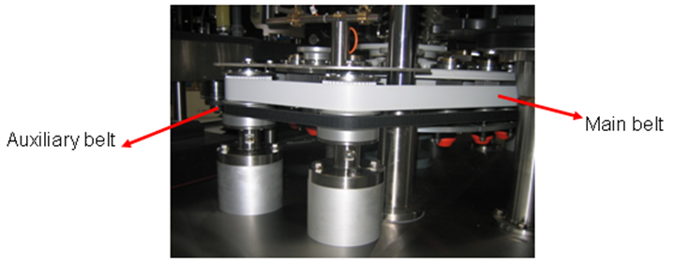
Reduce maintenance costs
Belt transmission
VALUE AND BENEFITS |  | DESCRIPTION
Reduced maintenance costs Quick format change Reduced costs for any new changeover Fine tuning |  | The transmission system consists of a brushless drive moving two belts (sometimes may be only one). The function of the main belt is to ensure stable platform rotation when the label is applied to the container. The auxiliary belt helps for a smooth ramp up when platform rotation begins.
Value: Efficiency
Equipment: Rollquattro labeler F25, F35 and F45 equipped with mechanical cam
Catalogue code: AA01

