Slide 1
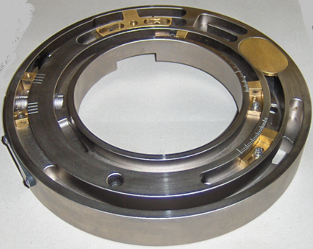
Reduce maintenance costs
Three channel distributor
VALUE AND BENEFITS |  | DESCRIPTION
Better tension control in the application of all labels, especially at high speeds Improves the quality of label application Easier for operators to set up the machine Reduces machine process sensitivity to variations in label materials |  | Allows a more comprehensive control of the label during transfer from the vacuum drum to the container. The additional channel provides a powerful and dedicated vacuum supply to the back pad of the label which gives positive control and releases the label during application.
Value: Efficiency
Equipment: Rollfed labeller F25, F35 and F45
Catalogue code: AA02

