Slide 1
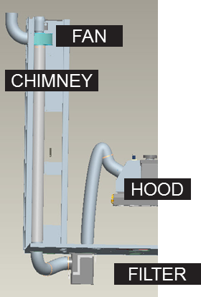
Improve labeling process and reduce maintenance
Glue fumes extractor
VALUE AND BENEFITS |  | DESCRIPTION
Reduced maintenance The fan aspirator is located at the end of the chimney. Due to the long distance from the filter and the fan, the glue particles not captured from the filter become cold along the pipe. In this way the accumulation of glue particles on the fan blades is consistently reduced and the fan life is also consistently prolonged. |  | One hood covering the glue roller A filter for glue particles, located under the labeling station basement, easily accessible for replacement and cleaning A fan aspirator placed at the end of the chimney, on the top of the labeler Connection pipes
Value: Efficiency
Equipment: Labellers (Rollquattro)
Catalogue code: AA04

