Slide 1
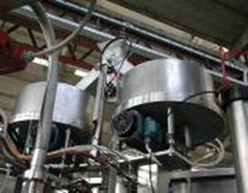
Increase production efficiency by eliminating cap blockages
Double hopper and channel
VALUE AND BENEFITS |  | DESCRIPTION
No stoppages through cap blockages Production efficiency increased |  | Fewer machine stoppages through cap jams, increasing filler efficiency. Second feed initiates on stoppage in the primary channel, automatically reactivated once the blockage has been eliminated. System consists of: Second hopper Second channel Double cap chute Cap divider Software
Value: Efficiency
Equipment: Fillers
Catalogue code: HS009

