Slide 1
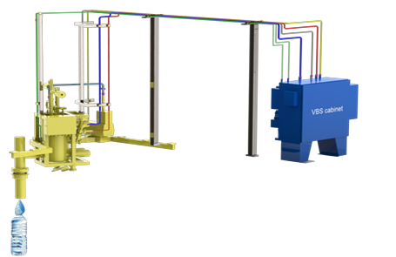
Increase shelf life and decrease the weight of your preforms
N2 Drop Upgrade Kit
VALUE AND BENEFITS |  | DESCRIPTION
Precise delivery of low-pressure liquid nitrogen on the highest speed package lines. High-speed liquid nitrogen dosing valve with the lowest liquid nitrogen consumption High-efficiency vacuum insulation Dose compensation allowing for fine adjustments of dose amount and timing during operation PLC controls with touch screen panel for ease of operation Precise liquid nitrogen dosing at all line speeds. Consistent pressure in every container Drastically reduced oxygen levels |  | A precisely timed drop of liquid nitrogen is dosed into the head space above the beverage in a bottle/can after filling and before sealing/capping. The cold liquid nitrogen (-196°C) turns into nitrogen gas at room temperature and expands rapidly. Since the bottle is capped at a certain time after dosing, this process creates a defined internal pressure in the bottle/can. The Nitrodose system has been developed to meet these requirements and to cut cost at the same time by providing a precise charge of liquid nitrogen.
Value: Product quality
Equipment: Fillers Eurostar RAA for PET- Eurotronica FM-C RVE – Eurostar HS REP - Starlight RBC - Stilljet RJT - Eurostar PN RVT – PRT - Starcans HS RSC - Bluestar RBS - Selecta C RFD - Eurotronica FM- S RFI - Europa WM - RFE
Catalogue code: HS035

